Slide 1
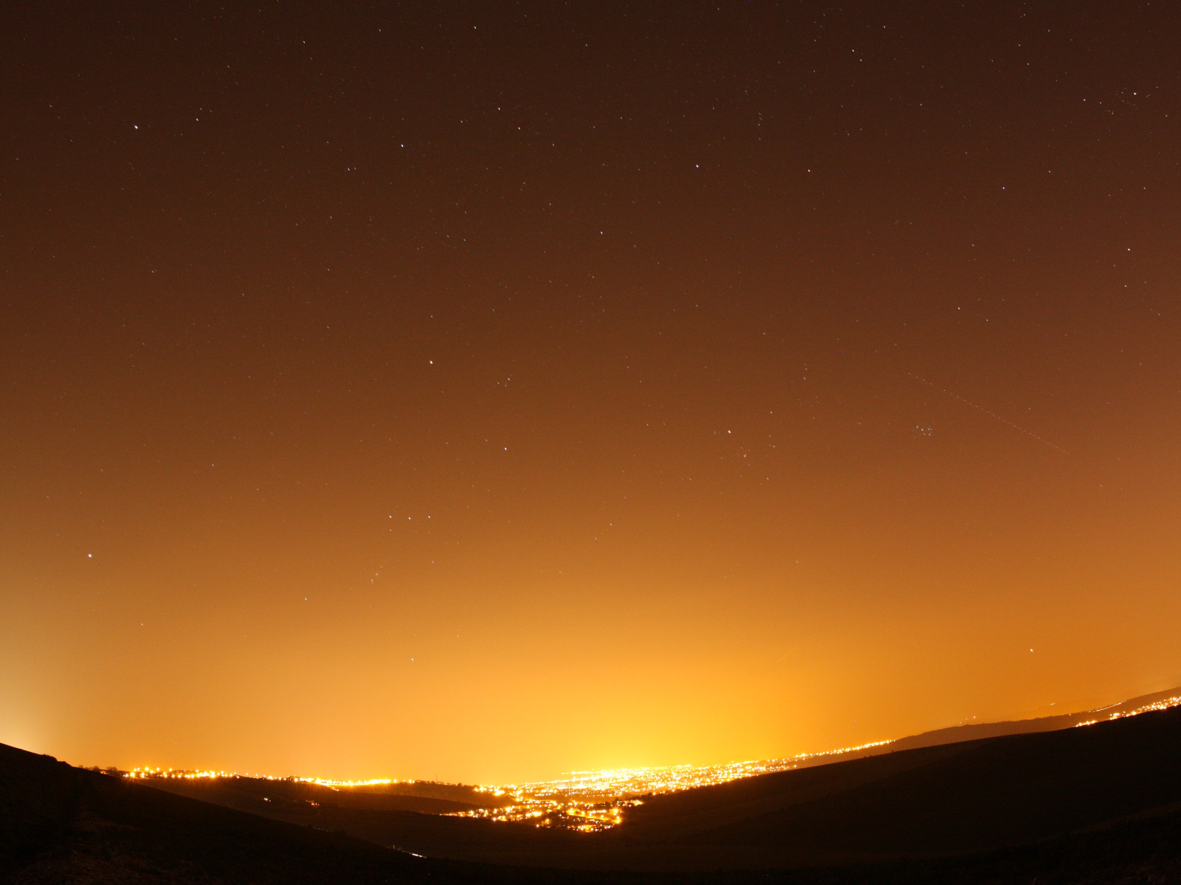
Shedding Light A survey of local authority approaches to lighting in England
Emma Marrington, Campaign to Protect Rural England
Notes:
We published a report of the survey findings in April 2014 as ‘SL’ – report and summary leaflet is available
Are there any LAs here who took part in the survey?

Slide 2
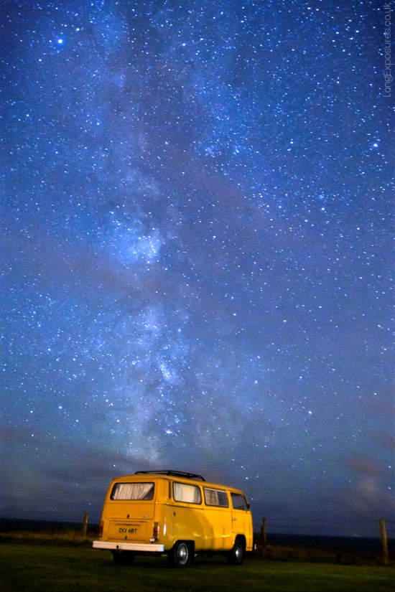
The presentation will cover…
Introducing CPRE and our interest in light pollution
About the survey
Key findings and recommendations
Conclusion

Slide 3
1. Introducing CPRE and our interest in light pollution
The Campaign to Protect Rural England was set up in 1926
CPRE county branch network
National CPRE light pollution campaigning – maps 1993/2000, Star Count, lighting nuisance
Notes:
Unlike many environmental charities, CPRE has no vested interests – we own no land, rely solely on donations and grants, and are politically independent.
We’ve helped win protection as National Parks for some of our most remarkable landscapes, from the Lake District to the South Downs. We’ve helped to influence and apply planning laws that have, against the odds, preserved the special beauty and character of the English countryside.
Interest in LP
CPRE has long been a leading voice in the campaign against light pollution.
We have a special interest in this issue: darkness at night is one of the key characteristics of rural areas and it represents a major difference between what is rural and what is urban.
But light doesn’t respect boundaries; it can spread for miles from the source and blurs the distinction between town and country.

Slide 4
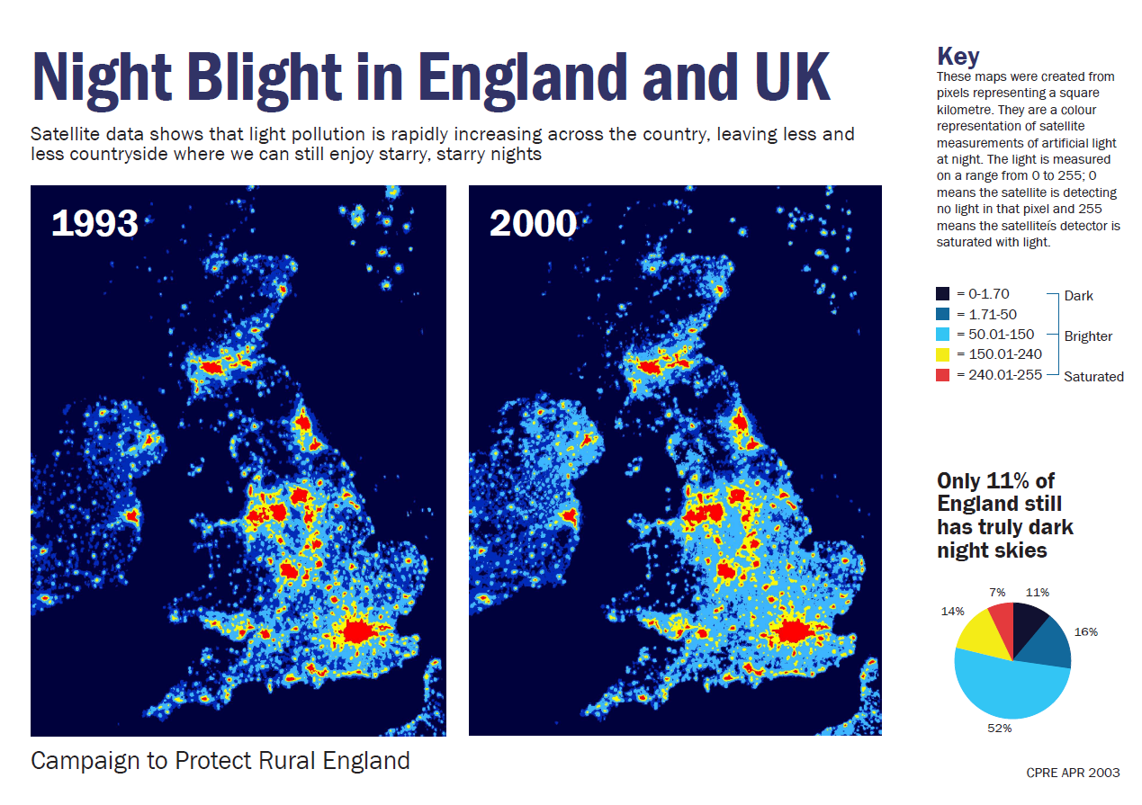
Notes:
Mapped in 1993/2000 launched in 2003 as Night Blight! campaign, using American weather satellite data
LP increased by 26% in England, 24% UK.
Regional variation e.g. East Midlands increased by 37% and variation by county e.g. Cumbria increased by 40%, Lincolnshire 46%
Data is still requested now, and has been used in AONB/NP Management Plans as well as informing local planning policies

Slide 5
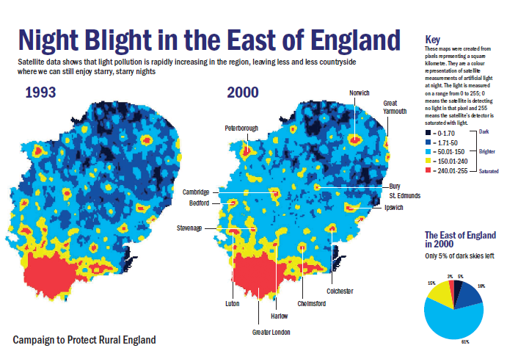
Notes:
Can see in the EoE an increase in the light blue band , showing how LP radiated out from towns and cities, urbanising surrounding rural areas 61% of region in this band
The spread of light has a huge impact on the character of dark landscapes, especially in rural areas where light pollution can mask a dark starry sky

Slide 6
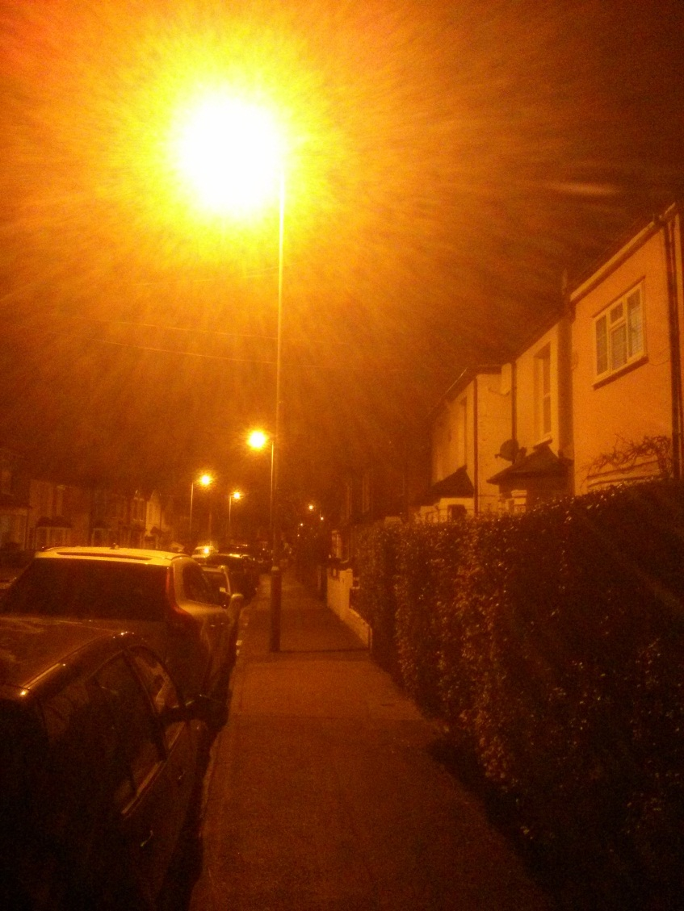
Public engagement initiatives
Lighting nuisance survey
How light pollution affects people’s lives
Clean Neighbourhoods & Environment Act (2005)
Experience
What people said about impact on their local landscape
Notes:
2010 - 1,358 people took part
83% had home view of night sky blighted by light pollution
Half of the respondents had their sleep disrupted by light spilling in to their bedrooms
Dealing with problem
68% have fitted thicker curtains
71% of people had not complained to anyone
about the lighting.
Almost a quarter (24%) had complained to their local council but only 27% said their council had been supportive.
Main culprits:
Road lighting 89%
Domestic security lights 79%
OLD STREET LIGHTS (>5 yrs old with orange glow) 77%
Businesses 56%
Sports grounds 53%
Supermarkets 41%
Comments – how do you feel about light pollution?
Unnecessary waste of resources with a complete disregard for the natural environment and the beauty of the surrounding landscape.
It is a shame, because it detracts from the amenity and beauty of what would otherwise be a lovely village. And leaving it on all night is completely unnecessary, providing no benefit to anyone.
Light pollution is a clear waste of energy and prevents people seeing the wonder of the night sky and appreciating their place in nature.
Memories of seeing the Milky Way as a child - but my grandchildren have never been able to see it.
An utter disgrace in the countryside - ruins the character of the night sky, ruins the peace and tranquillity, urbanisation of open country and small villages is taking place and it must be stopped. Legal requirement of light sources NOT to shine elsewhere is a priority.
Detracting from the character of the rural area over a very wide area affected by light spill
BUT THERE HAS BEEN SOME GOOD NEWS SINCE…

Slide 7
Lobbying for improved Government policy
National Planning Policy Framework policy:
‘By encouraging good design, planning policies and decisions should limit the impact of light pollution from artificial light on local amenity, intrinsically dark landscapes and nature conservation.’
Detailed guidance for local authorities
So CPRE surveyed councils in 2014 and published ‘Shedding Light’.
Notes:
NPPG
When is light pollution relevant to planning?
What factors should be considered when assessing whether a development proposal might have implications for light pollution? E.g. Is the development in or near a protected area of dark sky or an intrinsically dark landscape where it may be desirable to minimise new light sources?
What factors are relevant when considering where light shines?
What factors are relevant when considering when light shines?
What factors are relevant when considering how much the light shines?
What factors are relevant when considering possible ecological impact?

Slide 8
2. About the survey
Why CPRE carried out the survey
Question sections on:
Lighting and local planning (NPPF)
Street light switch-off and dimming schemes
Crime and street lighting
Type of lighting installed
New lighting in previously unlit areas
Who took part in the survey
Notes:
Why survey
Serious lack of information about how local authorities in England deal with lighting as part of the local planning process (e.g. new development), how they design street light switch off or dimming schemes, and how they decide which street lighting to install in new developments or when replacing existing schemes.
CPRE worked with the Department for Environment, Food and Rural Affairs (Defra) and the British Astronomical Association’s Campaign for Dark Skies (CfDS) in the development and design of the survey.
A CPRE county volunteer funded the project
Survey took place between January and February 2014
We sent our survey questionnaire to all county, district, borough, unitary and city authorities in England (a total of 351 authorities) with detailed questions about:
We received responses from 83 local authorities - including 17 county councils, 31 district councils, 10 metropolitan borough councils, 18 unitary authorities and seven London boroughs. This represents a 24% response rate. Responses were received from every English region.

Slide 9
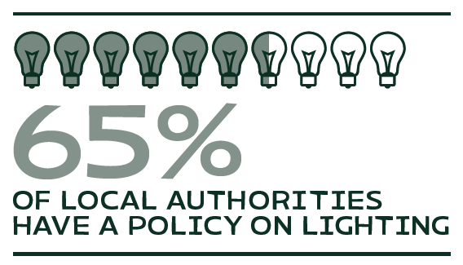
3. Key findings – Local planning and lighting
76 local authorities responded to the question on whether they had a lighting policy in either their Local Plan or related document, 49 of them (65%) said they did have a policy on lighting.
Notes:
Intro to NPPF and planning
In March 2012, the Government introduced the first ever policy to control light pollution in the NPPF. CPRE welcomed this as a significant step forward. Paragraph 125 of the NPPF states: ‘By encouraging good design, planning policies and decisions should limit the impact of light pollution from artificial light on local amenity, intrinsically dark landscapes and nature conservation.’ CPRE had campaigned for many years for planning guidance to control light pollution, so we welcomed this important move
National Planning Practice Guidance has also been published (in March 2014) on how local authorities should address light pollution. This Guidance sets out how the Government defines the link between lighting and planning Planning Practice Guidance: Light pollution http://planningguidance.planningportal.gov.uk/blog/guidance/light-pollution/
Local planning and lighting
LAs with policy - This includes 12 county councils, 16 district councils, four London Boroughs, seven Metropolitan Boroughs and ten unitary authorities.

Slide 10
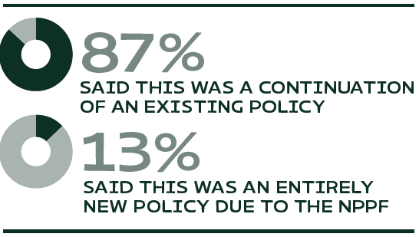
3. Key findings – Local planning and lighting
41 of 47 said that it was the continuation of a lighting policy they have had for some time
Compared with six who said it was an entirely new policy due to the NPPF
16 said they had adapted the lighting policy to comply with the NPPF whereas over two thirds (34) had not adapted their policy.

Slide 11
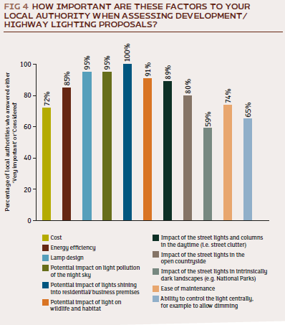
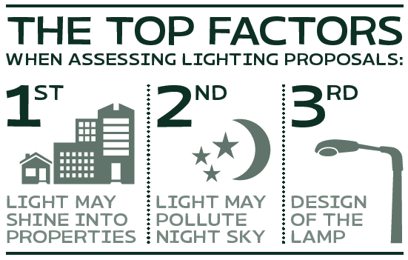
3. Key findings – Local planning and lighting
What type of development do you consider the lighting impact of? (80 responses)
New development – 78
Changed existing – 66
Highway proposal - 59
Notes:
Fig 3: The survey asked local authorities what type of developments they considered the lighting impact of. 80 authorities responded
- Any new development? 78 local authorities considered
- A change to lighting of an existing development? 66 local authorities considered
- A highway proposal? 59 local authorities considered
Example Dacorum, Hertfordshire. A planning application submitted for a change of use from household waste recycling centre to waste vehicle depot with the construction of new CCTV/lighting columns. The submitted lighting scheme was deemed unacceptable due to the sensitive location - classed as Zone E1 Lighting Zone, close to an SSSI, within the Chilterns AONB, open countryside and Green Belt - and a condition was imposed to address this.
The fact that just 59 local authorities reported that they consider the lighting impact of a highway proposal is due to the mixture of district and county level authorities responding to the question. County and unitary councils have responsibility for highway lighting in their areas but would consult relevant district councils when considering a new lighting scheme.
Fig 4: We asked local authorities how important a variety of factors were when assessing development/highway lighting proposals. Out of 74 who responded to this question VERY IMPORTANT OR CONSIDERED COMBINED BUT FOR JUST MOST IMPORTANT OVER TWO THIRDS OF COUNCILS SAID THAT ENERGY EFFIICIENCY WAS MOST IMP

Slide 12
3. Recommendations – Local planning and lighting
All local authorities should have a policy to control light pollution in their local planning documents, which includes identifying existing dark areas that need protecting;
Local authorities should consider preparing a Street Lighting Policy which could include Environmental Lighting Zones, with strict requirements for identified dark areas.
Notes:
NPPF/NPPG
ELZ to ensure that appropriate lighting levels are used in each zone, with strict requirement applying in identified dark areas example Hampshire and Norfolk

Slide 13
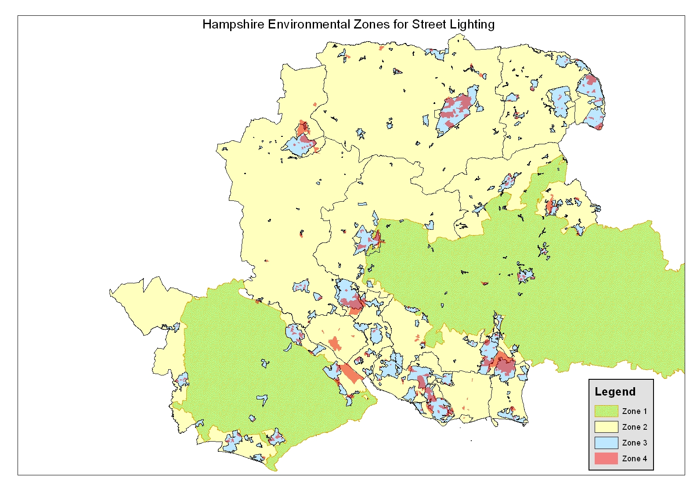

Slide 14
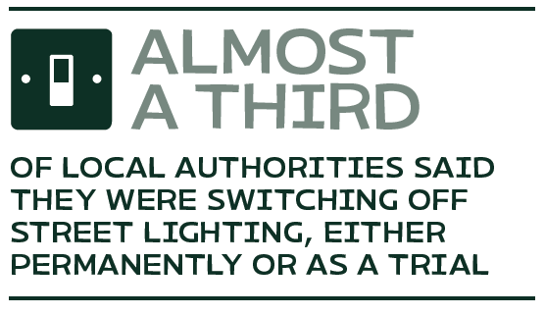
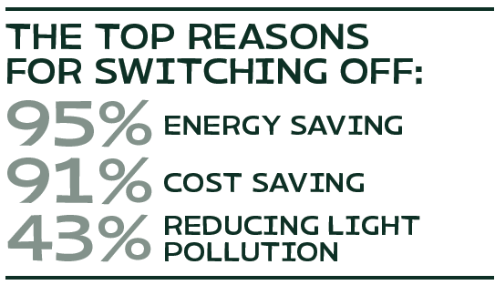
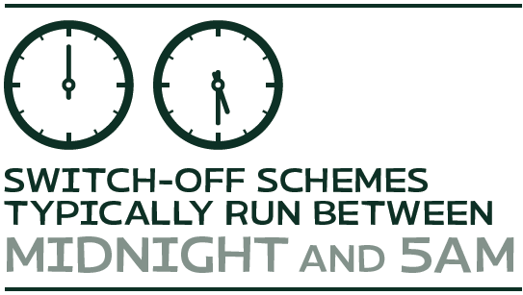
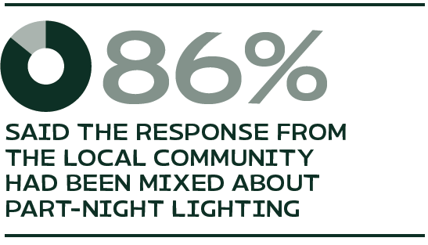
3. Key findings - Street light switch-off schemes
Notes:
Out of 71 local authorities who responded to this question almost a third (23) said they were switching off street lighting in their areas. Of these, 16 were permanent schemes and seven were trials. More than a third (39%) of the switch off schemes had been running for a year or two, and a further quarter (26%) had been running for less than a year.
Cost saving was a motivation for nine out of ten (91%) local authorities who were running a street light switch off scheme and eight out of ten (78%) of those running a dimming scheme.
Examples in this report are:
Sefton Council expects to save £15,000 during 2013/14 by trailing switching off alternate street lights.
Essex County Council previously spent approximately £ 4.6m million on electricity for street lighting each year but expect that switching to part night lighting will save approximately £1 million per year.
Bradford Council’s street light dimming scheme is designed to save £400,000 a year.
North Somerset Council estimates £300,000 a year will be saved following the completion of their dimming and part night lighting scheme.
Community
21 local authorities responded and the majority - 18 (86%) said the response had been mixed. This compares with two local authorities (10%) who said their community had been very supportive and one (5%) who said the community was not supportive.

Slide 15
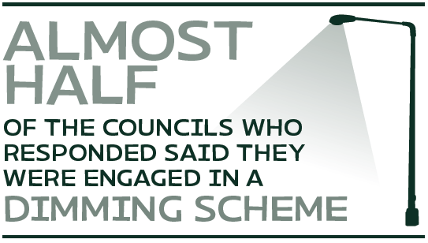
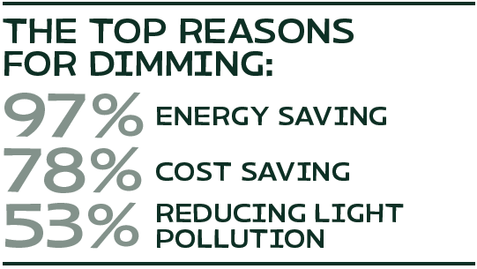
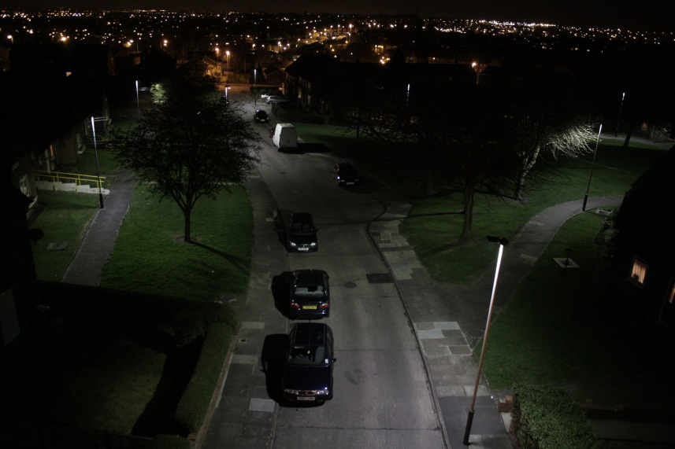
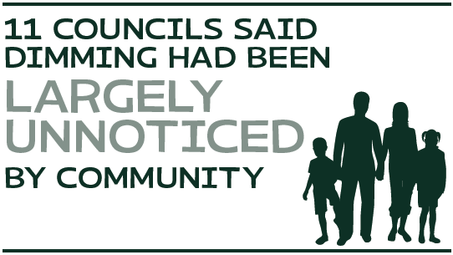
3. Key findings - Street light dimming schemes
Notes:
An increasing number of local authorities are investing in new lighting technology which can be dimmed – allowing local discretion for lighting levels.
Almost half (32) of the 67 respondents were engaged in a dimming scheme. 26 said it was permanent compared with five who are currently running dimming trials.
Three quarters (23) of the 31 local authorities who stated how long they had been running a dimming scheme said that it had been for under three years with the remainder reporting that their scheme had been running for between three and five years.
Example in Leicester , new CMS, mix of white light and LEDs – allows dimming 75% between 8pm and dawn
Examples of energy saving
Shropshire County Council hopes to save up to 600 tonnes of CO2 per year, which is around 15% of current street lighting emissions as a result of their part-night lighting trial.
Essex County Council expects to reduce carbon emissions by over 8,000 tonnes per year due to their part night lighting scheme.
Derbyshire County Council has a commitment to reduce carbon emissions by 25% by 2015 which it hopes to achieve due to part night lighting scheme.
Leicestershire County Council is aiming to reduce carbon emissions by 30% by 2014 by dimming and part night lighting scheme.
Cornwall County Council hopes to save up to 4,700 tonnes of CO2 per year due to part night lighting and dimming trial.

Slide 16
3. Recommendation – Street light switch-off and dimming schemes
We encourage local authorities to investigate how part-night lighting schemes or dimming could work in their areas. including examining the cost, energy and carbon savings.
Notes:
including examining the cost, energy and carbon savings.
Summary points
There is increasing interest among local authorities to find new ways to save money and reduce energy consumption and carbon emissions.
Almost a third (23) of local authority respondents said they were involved in switching off street lights typically between midnight and 5am
32 said they were involved in dimming street lights in their areas
The right lighting should be used only where and when it is needed
Public consultation is vital to the success of any adjustment to street lighting in an area.
All of the local authorities who were responsible for a street light switch off scheme said they had consulted the affected communities.
Dimming schemes are significantly more popular with residents with 68% of local authorities saying their communities had been very supportive, compared with only 10% of communities who were very supportive of switching off street lights overnight.

Slide 17
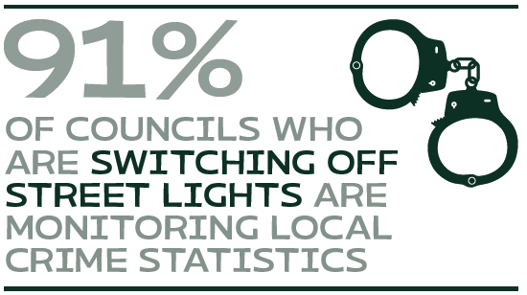
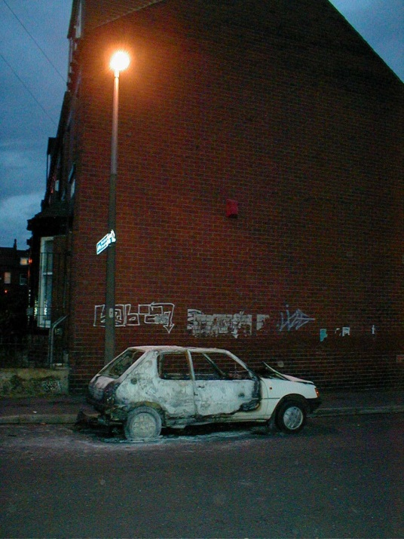
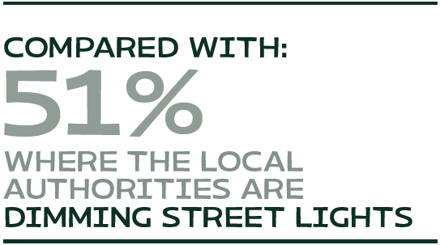
3. Key findings – Crime and street lighting
Notes:
Points:
A Home Office Research Study in 2002 (and a consequent update in 2008) argued that crime levels are reduced by up to 38% by improvements to street lighting. The research has been questioned by a leading statistician at Leeds Metropolitan University.
Impact of lower light levels is a common, and understandable, concern for residents re part night lighting or dimming schemes.
No clear link from this survey
‘Fear of crime’ is an important issue that - community consultation.
ILP/LANTERNS project: Local Authority Collaborators’ National Evaluation of Reduced Night-time Streetlight
The ILP/LANTERNS project, launched in April 2013, is a research collaboration between local authorities in England & Wales and researchers at the University of London. It aims to quantify any effects of changes to street lighting on road traffic crashes and crimes. 69 involved in April 2014
Recommendation
All LPAS who switch off or dim should monitor crime and accident stats and consider taking part in LANTERNS project

Slide 18
3. Key findings and recommendations – Type of lighting
Key findings:
LED lighting most popular (32)
Followed by high pressure sodium white lights (29)
Lamp design was most important factor (87%)
Recommendations:
Local authorities should give careful consideration to the type of LED lighting they use;
Set targets for replacing all street and road lights with less light polluting types, such as full cut off flat glass lamps;
new street lighting should be tested 'in situ' before a lighting scheme is rolled out across a wider area.
Notes:
57 responses re lighting types
Choosing new street lamps - factors in order of importance
- Lamp design 87%
Potential impact of lights shining into residential/business premises 85%
Energy efficiency
Ease of maintenance
Colour Rendition Index (CRI) 85%
Cost 84%
Potential impact of light pollution in the night sky 83%
The Colour Rendition Index measures a light source's colour characteristics.
LED REC: Consider the potential impacts that higher temperature blue rich lighting has on ecology and on human health;
In situ: to ensure that it is the minimum required for the task and does not cause a nuisance to residents.

Slide 19
3. Key findings and recommendations – New lighting in previously unlit areas
Top reasons for considering new lighting (23 responses)
Crime/fear of crime (13)
Public demand (12)
Road safety (10)
New development (9)
Guidance used (55 responses)
Highways Agency Design Manual for Roads and Bridges (24)
ILP guidance (12)
Recommendations:
Strong presumption against new lighting in existing dark areas (unless ‘essential)
Highways Agency review of DMRB
Notes:
How do local authorities decide whether to install new lighting in previously unlit areas and what guidance do they use?
CPRE wanted to find out how local authorities make decisions about installing new lighting in previously unlit areas, e.g. a village, and what advice they use.
A section of the Department for Transport/Highways Agency Design Manual for Roads and Bridges (DMRB) is often used to inform design of lighting on motorways and trunk roads. The two most relevant policies are TD34: Design of Road Lighting for the Strategic Motorway & Trunk Road Network and TA49: Appraisal of New & Replacement Lighting on the Strategic Motorway & All Purpose Trunk Road Network. CPRE has worked with the Highways Agency to review TD34 and an updated version is due to be published in 2014. The Highways Agency is also considering a review of TA49 to ensure that the lighting for new schemes is only installed as necessary.
We asked respondents whether they felt the Design Manual for Roads and Bridges (DMRB) could be improved, of the 22 local authorities who replied more than half of them (55%) felt it could be improved, with 45% saying it did not need to be improved.
Essential – as part of new devltp or public safety reasons clearly shown

Slide 20
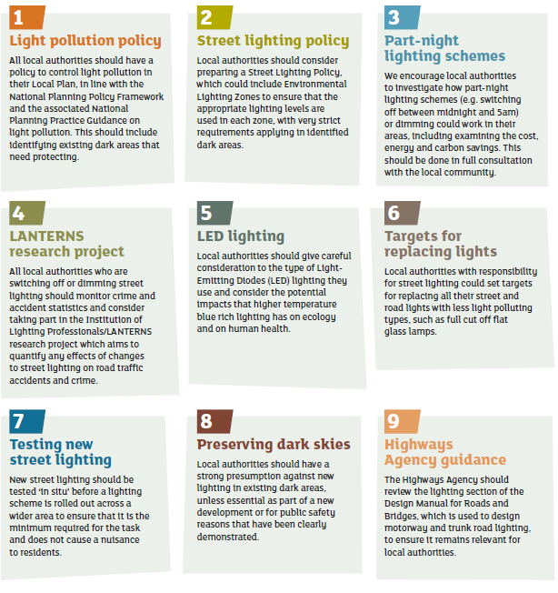
4. Conclusion
Recommendations
Light pollution policy
Zoning
Sensitive lighting
Preserving dark skies

Slide 21
Questions?
Emma Marrington
emmam@cpre.org.uk
Notes:
How do local authorities decide whether to install new lighting in previously unlit areas and what guidance do they use?
CPRE wanted to find out how local authorities make decisions about installing new lighting in previously unlit areas, e.g. a village, and what advice they use.
A section of the Department for Transport/Highways Agency Design Manual for Roads and Bridges (DMRB) is often used to inform design of lighting on motorways and trunk roads. The two most relevant policies are TD34: Design of Road Lighting for the Strategic Motorway & Trunk Road Network and TA49: Appraisal of New & Replacement Lighting on the Strategic Motorway & All Purpose Trunk Road Network. CPRE has worked with the Highways Agency to review TD34 and an updated version is due to be published in 2014. The Highways Agency is also considering a review of TA49 to ensure that the lighting for new schemes is only installed as necessary.
We asked respondents whether they felt the Design Manual for Roads and Bridges (DMRB) could be improved, of the 22 local authorities who replied more than half of them (55%) felt it could be improved, with 45% saying it did not need to be improved.
Essential – as part of new devltp or public safety reasons clearly shown

