Slide 1
PROTECTING DARK LANDSCAPES
Case Studies of Local Best Practice
David Hook
Light Pollution Campaign Co-ordinator
CPRE Norfolk
DAVID HOOK, CPRE NORFOLK
CPRE NORFOLK LIGHT POLLUTION CONFERENCE 2015

Slide 2
WHY IS LIGHT POLLUTION A PROBLEM?
It obscures our view of the stars and is a serious hindrance for astronomers
It suburbanises the countryside and threatens rural character and tranquillity
It has negative impacts on the health of plants and animals – including humans
It can affect property owners who suffer intrusive glare from a neighbour’s light(s)
Unnecessary and poorly designed lighting wastes money, increases CO2 emissions and contributes to a depletion of the earth’s energy resources
DAVID HOOK, CPRE NORFOLK
CPRE NORFOLK LIGHT POLLUTION CONFERENCE 2015

Slide 3
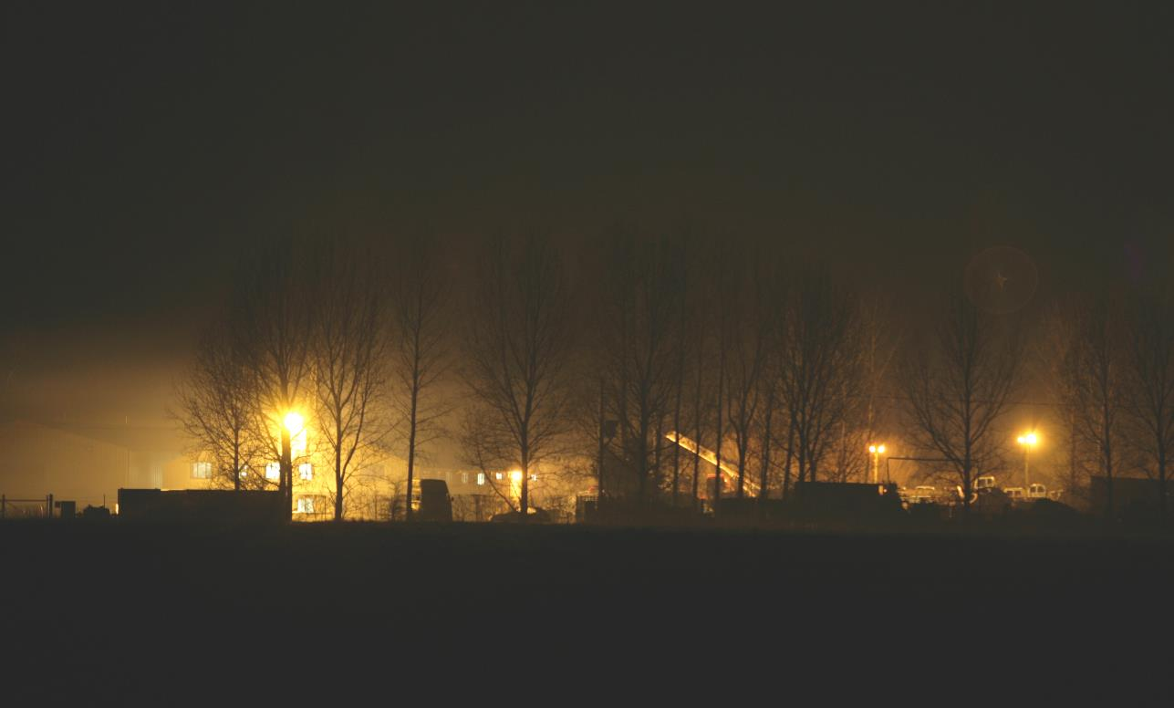
SEETHING INDUSTRIAL ESTATE
DAVID HOOK, CPRE NORFOLK
CPRE NORFOLK LIGHT POLLUTION CONFERENCE 2015

Slide 4
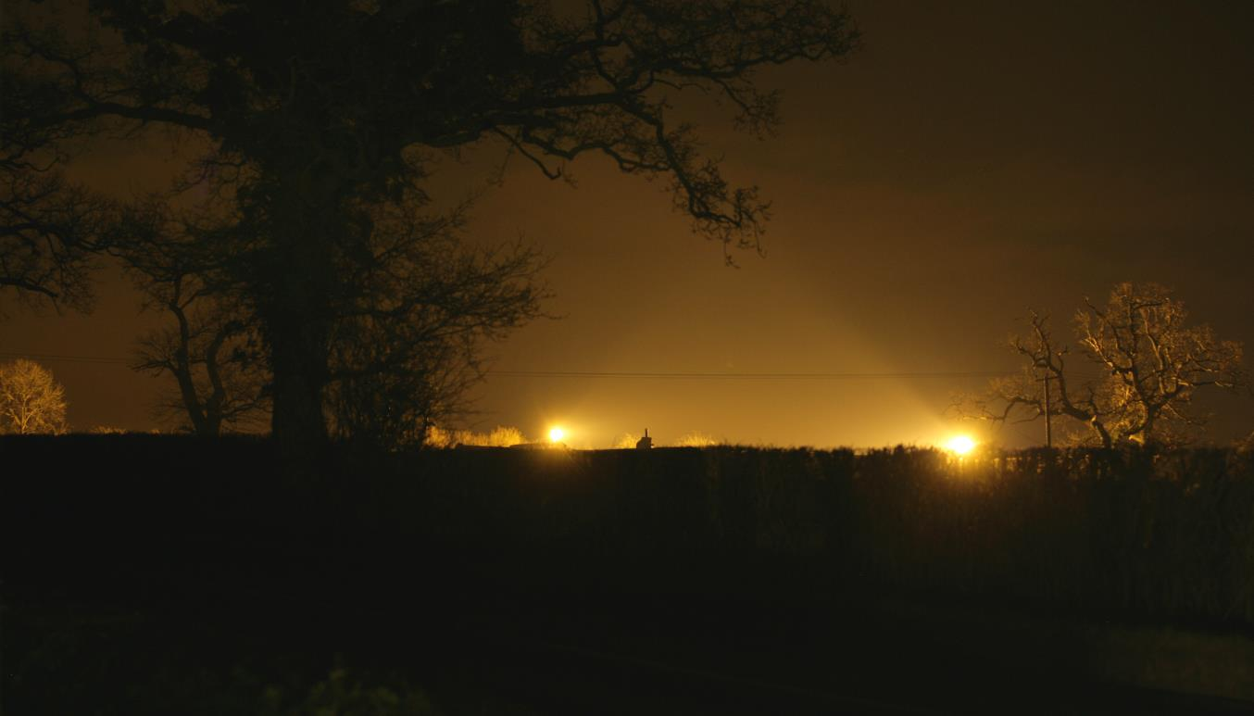
LIGHT POLLUTION AT MORNINGTHORPE
DAVID HOOK, CPRE NORFOLK
CPRE NORFOLK LIGHT POLLUTION CONFERENCE 2015

Slide 5
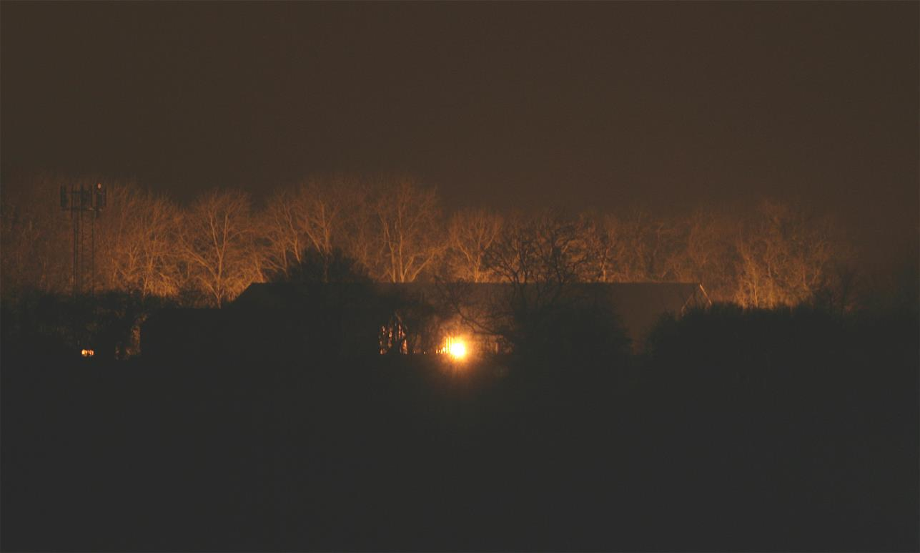
HEMPNALL LAWN MOWER CENTRE
DAVID HOOK, CPRE NORFOLK
CPRE NORFOLK LIGHT POLLUTION CONFERENCE 2015

Slide 6
PLANNING POLICY
National Planning Policy Framework Paragraph 125
“By encouraging good design, planning policies and decisions should limit the impact of light pollution from artificial light on local amenity, intrinsically dark landscapes and nature conservation.”
Highways Agency TD34
Ensures full cut off flat glass lighting on motorways and trunk roads, including those in Norfolk.
CPRE/CfDS involvement in the Policy.
DAVID HOOK, CPRE NORFOLK
CPRE NORFOLK LIGHT POLLUTION CONFERENCE 2015

Slide 7
PLANNING POLICY - NORFOLK
Norfolk County Council’s Environmental Lighting Zones Policy and Maps
Gives protection to Rural Dark Landscapes and recognition of their importance to the character of Norfolk for the benefit of both residents and visitors.
Fully shielded ‘cut off lamps’ will be used on all lighting schemes in areas classified as Rural Dark Landscape.
The policy applies to all street lights that are the responsibility of the County Council and is also advisory in respect to non County Council lighting.
Examples of its impact - A140 lighting, Trowse bypass, Cawston parish, Scole by-pass
DAVID HOOK, CPRE NORFOLK
CPRE NORFOLK LIGHT POLLUTION CONFERENCE 2015

Slide 8
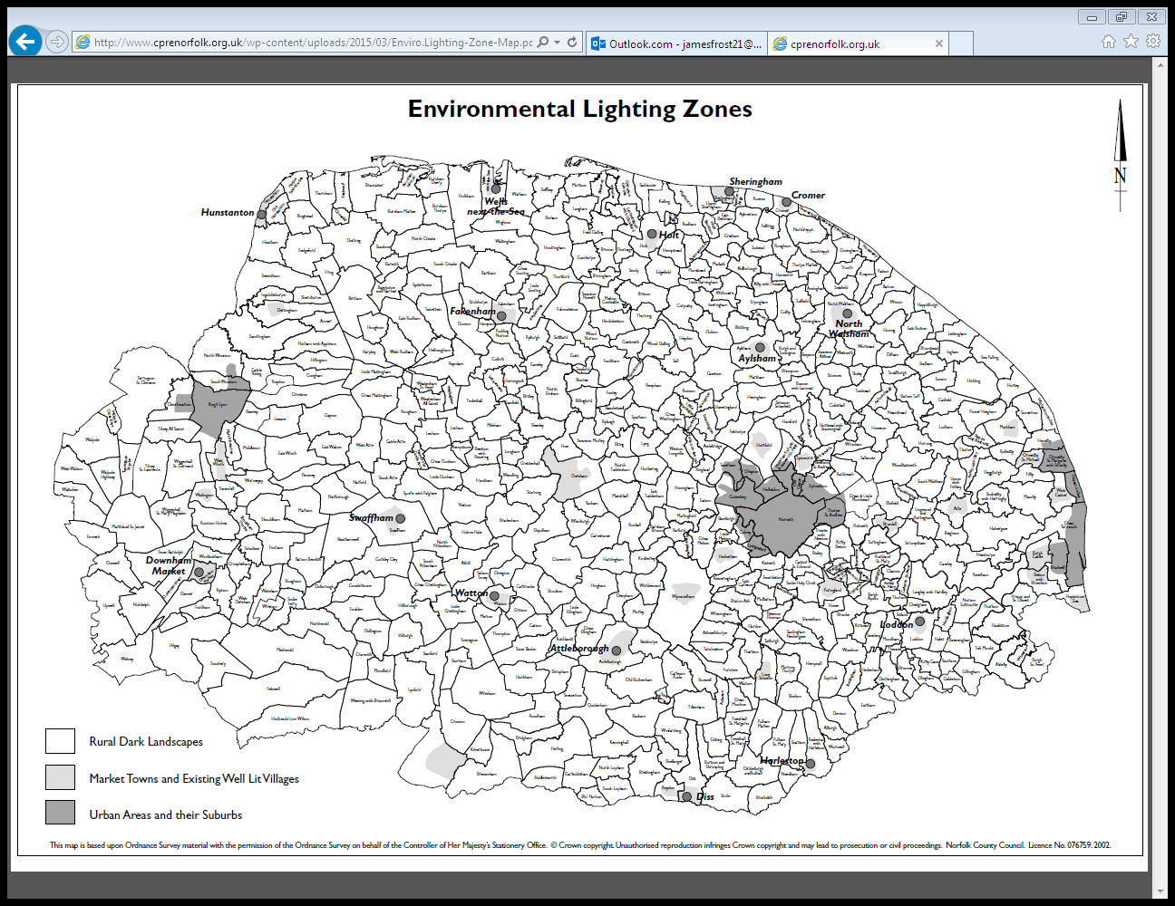
DAVID HOOK, CPRE NORFOLK
CPRE NORFOLK LIGHT POLLUTION CONFERENCE 2015

Slide 9
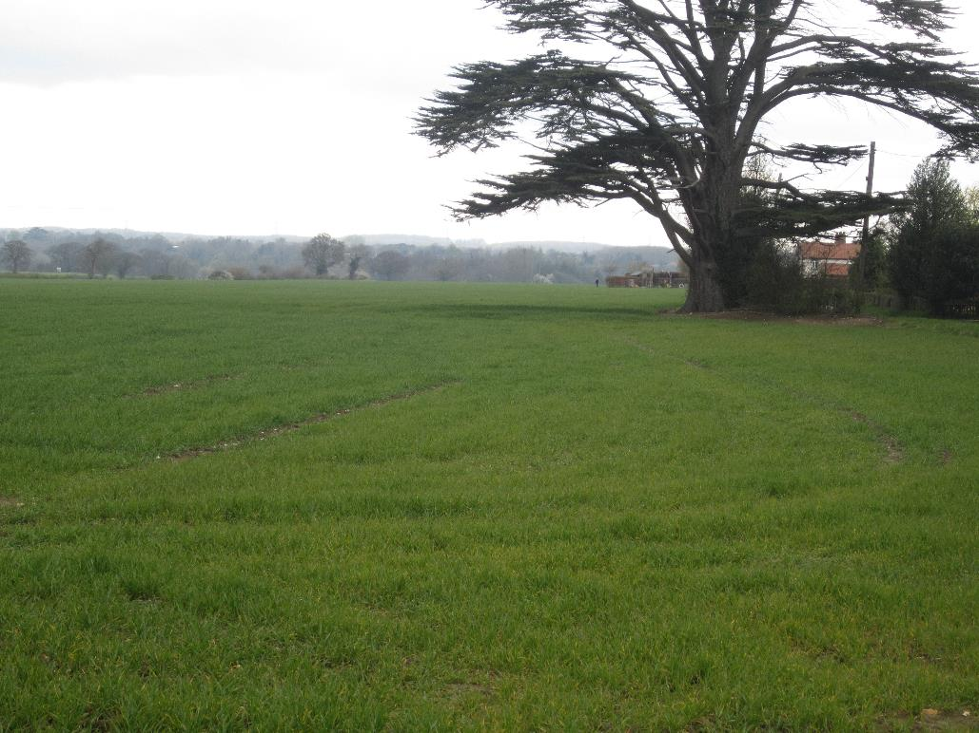
EXAMPLE: A140 / B1527 JUNCTION BY DAY
DAVID HOOK, CPRE NORFOLK
CPRE NORFOLK LIGHT POLLUTION CONFERENCE 2015

Slide 10
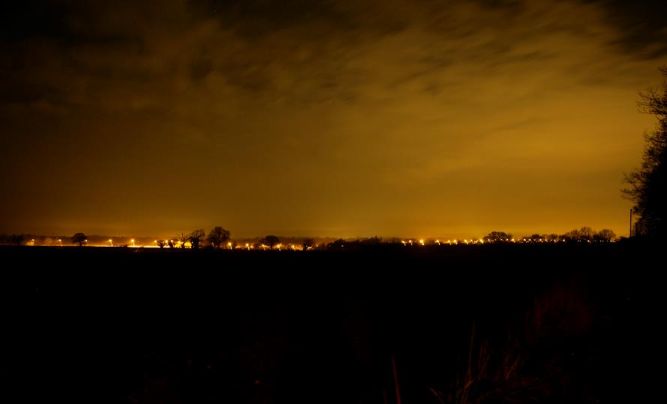
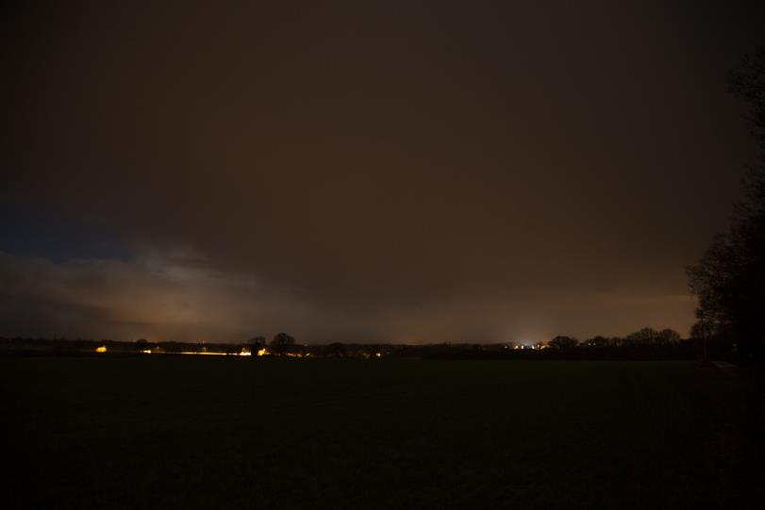
EXAMPLE: A140 / B1527 JUNCTION BY NIGHT
BEFORE: LOW PRESSURE SODIUM LIGHTS AFTER: FULL CUT OFF G4 LIGHTS
DAVID HOOK, CPRE NORFOLK
CPRE NORFOLK LIGHT POLLUTION CONFERENCE 2015

Slide 11
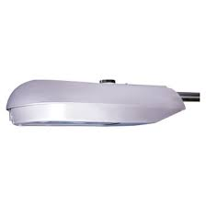
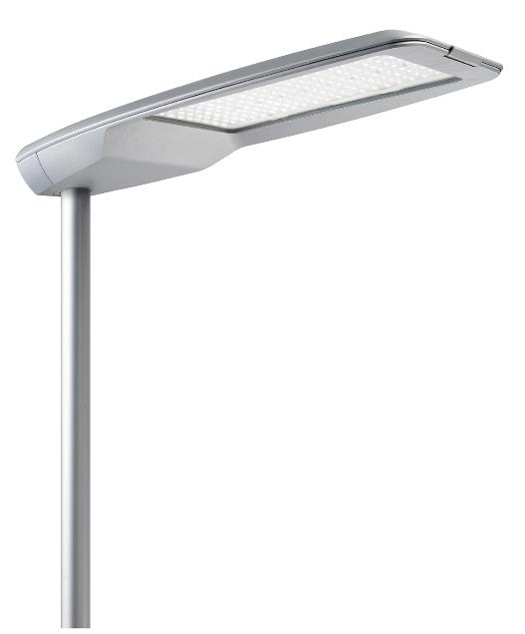
RECOMMENDED LIGHTING
A FULL CUT OFF FLAT GLASS LAMP A SHIELDED LED LAMP
DAVID HOOK, CPRE NORFOLK
CPRE NORFOLK LIGHT POLLUTION CONFERENCE 2015

Slide 12
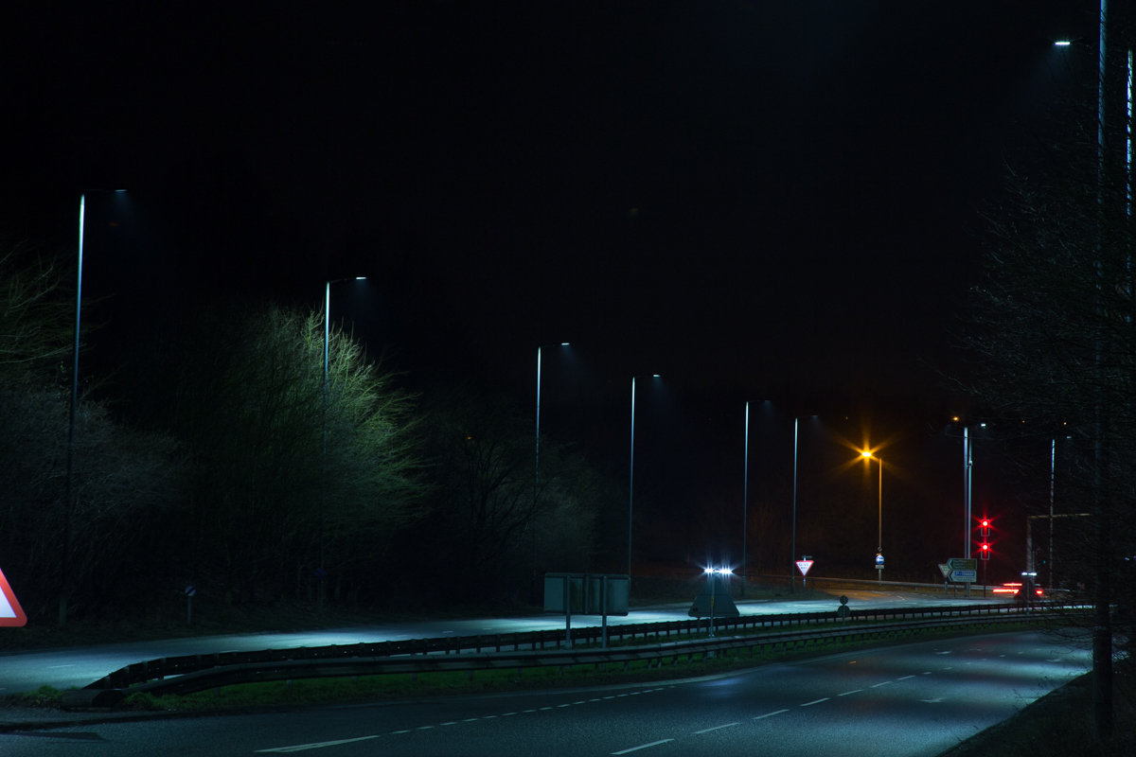
EXAMPLE: LED LAMPS – TROWSE BYPASS
DAVID HOOK, CPRE NORFOLK
CPRE NORFOLK LIGHT POLLUTION CONFERENCE 2015

Slide 13
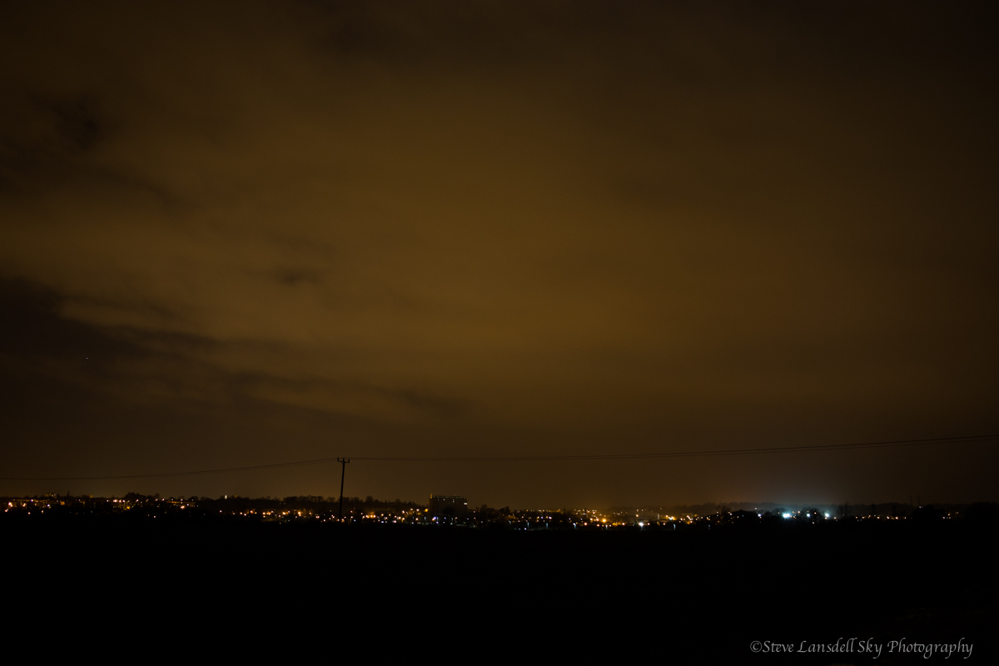
EXAMPLE: TROWSE BYPASS FROM A DISTANCE
DAVID HOOK, CPRE NORFOLK
CPRE NORFOLK LIGHT POLLUTION CONFERENCE 2015

Slide 14
PLANNING POLICY - DISTRICT
All Norfolk District Councils have policies on outdoor lighting / light pollution
(effective when applied to individual planning applications)
South Norfolk Council Policy IMP 25 (Outdoor lighting)
North Norfolk District Council Policy EN13
Breckland Council Policy DC 1 (Protection of Amenity)
Broadland District Council’s emerging Development Management Policies include EN2 (Landscape)
Borough Council of Kings Lynn and West Norfolk Policy DM15 (Environment, Design and Amenity)
Case study: Sugar Beat Public House, Swainsthorpe
DAVID HOOK, CPRE NORFOLK
CPRE NORFOLK LIGHT POLLUTION CONFERENCE 2015

Slide 15
LOCAL ACTION
Parish Council Action
Adoption of CPRE Norfolk Light Pollution Clause to attach to all planning application responses
(Case Study: Hempnall Poultry Sheds).
Be the eyes and ears at grassroots level: report problems / ask offenders to change lights.
Individual Action
Can achieve a lot especially when supported by LPA / CPRE
(Case Study: Sheringham Car Park).
Concerns
Policy is often only advisory. Many of the real light pollution problems are not covered by current planning controls (for example: some farm and rural business lights).
DAVID HOOK, CPRE NORFOLK
CPRE NORFOLK LIGHT POLLUTION CONFERENCE 2015

Slide 16
OTHER CASE STUDIES
NPS Schools Lighting
Commitment to good lighting practice at a number of school sites.
Well shielded lamp fitments, low energy white light sources and operating with a curfew (timer switch).
Secured by Design
‘Security badge’ for new developments.
Norfolk Constabulary award SBD status in some rural locations without the need for external lighting.
Norfolk Environmental Waste Services
Replacement of ‘dusk to dawn’ sodium lights at all waste and recycling sites across the county.
New movement sensor white lights installed.
DAVID HOOK, CPRE NORFOLK
CPRE NORFOLK LIGHT POLLUTION CONFERENCE 2015

Slide 17
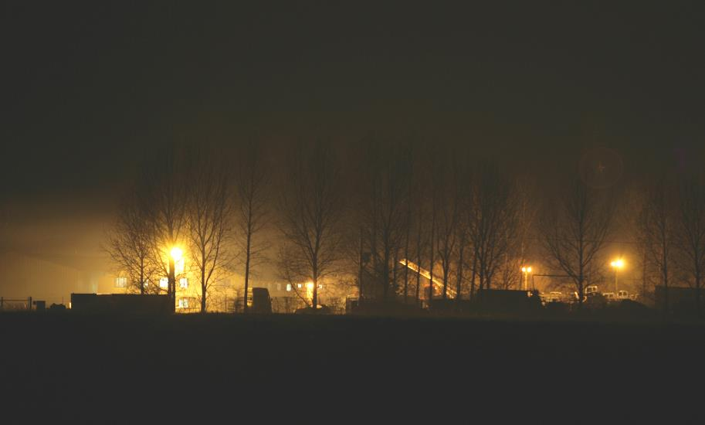
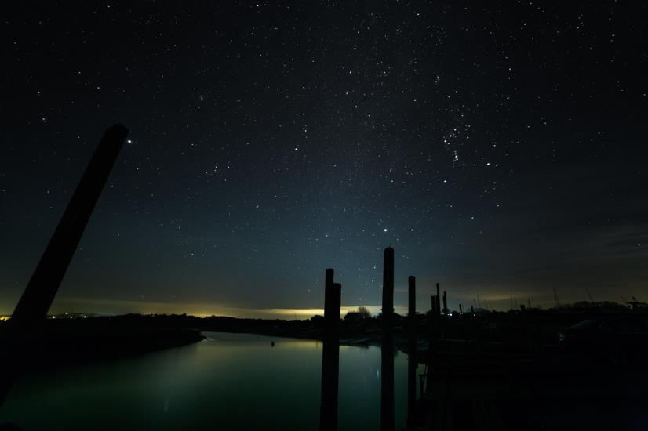
FINAL THOUGHT…THE BAD AND THE GOOD
SEETHING INDUSTRIAL ESTATE MORSTON QUAY
DAVID HOOK, CPRE NORFOLK
CPRE NORFOLK LIGHT POLLUTION CONFERENCE 2015

Slide 18
CONTACT
David Hook: 01508 498187 / hookd74@yahoo.com
For downloads, case studies, planning policy summaries and detailed information about our light pollution campaign:
www.cprenorfolk.org.uk/light-pollution
DAVID HOOK, CPRE NORFOLK
CPRE NORFOLK LIGHT POLLUTION CONFERENCE 2015

Slide 19
QUESTIONS?
Emma Marrington
Senior Rural Policy Campaigner, CPRE
David Hook
Light Pollution Campaign Co-ordinator, CPRE Norfolk
CPRE NORFOLK LIGHT POLLUTION CONFERENCE 2015

Slide 20
CPRE NORFOLK
LIGHT POLLUTION CONFERENCE 2015
CPRE NORFOLK
LIGHT POLLUTION CONFERENCE 2015
Julian Study Centre,
University of East Anglia
CPRE NORFOLK LIGHT POLLUTION CONFERENCE 2015

